Slide 1
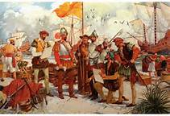
U.S History E.O.C.T.
Part I
Colonization to Constitution

Slide 2
Domain I
Standards 1 - 5
Settlement of North America in the 17th century.
The economic and social development of British North America.
The causes of the American Revolution.
U.S. Constitution

Slide 3
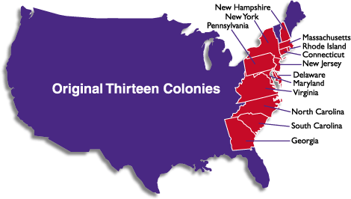
Colonial Period
Standard 1

Slide 4
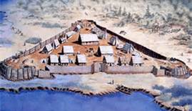
Virginia
Jamestown, Virginia was the first permanent English settlement in the Americas.
A corporate colony, founded by the Virginia Company.
Investors hoped to make a profit from the colony.
Colonists were sent to find gold and other valuable natural resources.

Slide 5
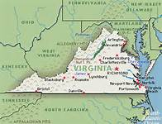

Success of the Virginia Colony
The colonists did not discover any gold, but they learned how to cultivate tobacco.
Tobacco became the most profitable cash crop.
Headright System allowed families to move in and own land.

Slide 6
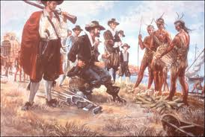
Relationship with Powhatan Indians
Native Americans had lived for centuries on the land the English settlers called Virginia.
The colonist pushed the Powhatans off their land so that it could be used for agriculture, especially to grow tobacco.
Powhatan’s were hostile toward the new settlers.
They attacked Jamestown.
English Capt. John Smith was able to negotiate with them for food. He forced the colonists to farm or face starvation.

Slide 7
Virginia’s House of Burgesses
Virginia’s colonial legislature. First system of government in the new settlement.
House of Burgesses allowed self-government
Nathaniel Bacon led a rebellion because the legislature failed to provide settlers protection from hostile Indians in the backcountry.
The H.O.B. put down the rebellion and passed laws to regulate slavery so that poor white colonists would no longer side with slaves against rich white colonists.

Slide 8
First Africans in Virginia
In 1619 a Dutch slave ship arrived in the colony.
The Africans on board (who were destined to be traded as slaves in the West Indies), were traded for supplies in Virginia.
The Virginia colony treated the Africans as indentured servants, not slaves.
All of them eventually gained their freedom before slavery was introduced in Virginia.

Slide 9
Sample Question
One reason the colony of Virginia succeeded was the
profitable tobacco crop
leadership of John Smith
management of the Virginia Company
relationship with the Powhatan Indians

Slide 10
Answer:
A: the profitable tobacco crop

Slide 11
New England
Originally settled by English Separatists, who had broken away from the Anglican Church
They were persecuted
These settlers were called “Pilgrims”
They sailed on the Mayflower from England to America

Slide 12
Massachusetts Bay Colony
Settled by English Puritans (who were Anglican, but wanted to reform the Church of its “Catholic” practices)
They were persecuted in Great Britain
They established their “City Upon A Hill”, what they considered a model utopia, in Boston

Slide 13
Puritans vs. Native Americans
King Philip’s War
  Chief of the Wampanoag's (Metacom/”King Philip”) led an attack on the Puritans in response to their laws that restricted the Indians
  It was a very brutal and destructive war
  Food shortages, disease, and heavy casualties kept the Indians from fighting
  Metacom was killed and the Indian resistance in New England ended

Slide 14
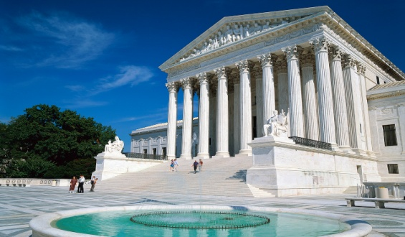
Tension in New England
Roger Williams challenged forced religion on the citizens of Massachusetts
He was exiled and eventually founded the colony of Rhode Island
Separation of church and state established in Rhode island

Slide 15
Halfway Covenant
Allowed partial church membership for the children and grandchildren of the original Puritans.
As more and more children were born in America, many grew up to be adults who lacked a personal covenant (relationship) with God, the central theme of Puritanism.

Slide 16
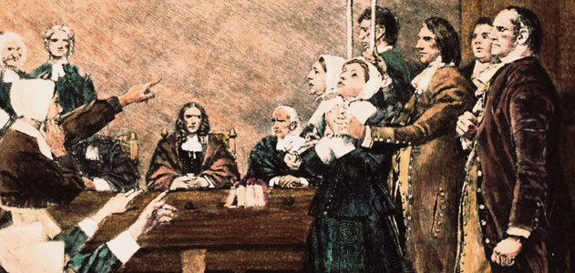
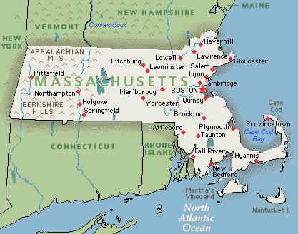
Salem Witch Trails
The Salem witch trials were a series of hearings and prosecutions of people accused of witchcraft in colonial Massachusetts.
In a series of court hearings, over 150 Massachusetts colonists were accused of with craft were tried, 29 were convicted and 19 hanged.

Slide 17
Massachusetts Bay Loses Its Charter
Puritans refused to obey English law
In 1684, King Charles II revoked the colony’s corporate charter
Massachusetts became a royal colony, under strict control of the king

Slide 18
Sample Question
Which factor directly affected the settlement of New England in the 1600s?
Religious persecution in Great Britain
The opportunity to cultivate tobacco
Growing conflict with the southern farmers
The chance to participate in the slave trade

Slide 19
Answer:
A: religious persecution in Great Britain

Slide 20
Mid-Atlantic Colonies
New Netherlands to New York
Originally claimed and settled by Netherland
  Diverse Population (settlers were allowed from all over Europe)
James, Duke of York and brother of King Charles II, sent a fleet of ships to take the colony away from the Dutch
  It was accomplished without firing a single shot
  It became the English colony of New York

Slide 21
Pennsylvania
Founded by religiously tolerant Quakers led by William Penn.
Quakers were first settlers
Penn’s “Holy Experiment”: allowed freedom of religion

Slide 22
Sample Question
The original settlers of the Mid-Atlantic colonies were
Pilgrims
Quakers
Puritans
Dutch

Slide 23
Correct Answer:
D: Dutch

Slide 24
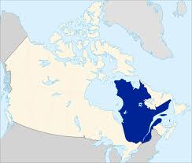
French Settlement of Quebec
France settled colonies to secure the valuable natural resources of North America and export them to Europe.
Quebec was the first permanent French settlement in North America.
The French instructed their colonists to spread the Catholic faith in the New World.

Slide 25

Standard 2
Mercantilism
The theory of mercantilism held that a the Earth had a limited supply of wealth in the form of natural resources, especially gold and silver, so the best way to become a stronger nation was to acquire the most wealth.
The more American goods the British could sell to other countries, the less money those countries would have for themselves.
Great Britain would get stronger, and its European rivals would get weaker.
Export raw materials from colonies to England.
The British would sell manufactured goods back to the colonies.

Slide 26
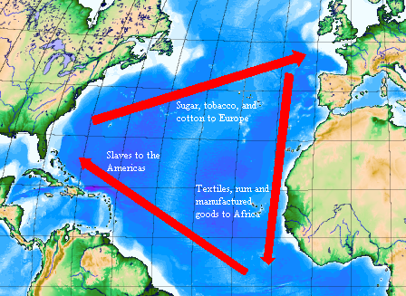
Triangular Trade Route

Slide 27
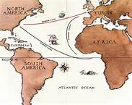
Transatlantic Trade
Mercantilism also inspired Parliament to control transatlantic trade with its American colonies.
All goods shipped to or from British north America had to travel in British ships, and any goods exported to Europe had to land first in Britain to pay taxes.
These restrictions were designed to keep the colonies from competing against Britain.

Slide 28
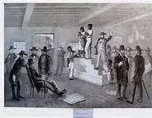
African Colonial Population
As employment opportunities increased in England, fewer indentured servants came to America
Transatlantic trade included stops along the African coast to trade rum (from New England) and guns and manufactured goods (from England) in exchange for slaves
Slaves were taken to the West Indies and various parts of North America in the Middle Passage of the transatlantic trade

Slide 29
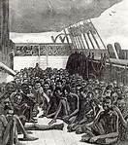
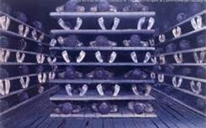
Middle Passage
The sea voyage that carried Africans to North America was called the Middle Passage.
The Middle passage refers to the middle portion of a three-way voyage made by slave ships.
First, British ships loaded with rum, cloth, and other British goods sailed to Africa.
While in Africa, they were traded for Africans originally enslaved by other Africans.

Slide 30
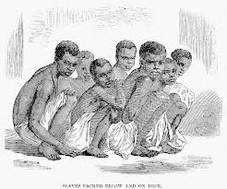
During the Middle passage, slaves would be transported to the New World.
The crew would buy tobacco and other American goods using profits they made from selling the slaves in the colonies.
They could ship the tobacco and goods back to Britain.
This process was repeated for decades.

Slide 31
Sample Question:
  Rum
  Slaves
  Manufactured goods
The items listed above were part of the
Products produced in the New England colonies
Products traded to England from the American colonies
Items traded along the transatlantic trade
Items England provided to its American colonies

Slide 32
Correct Answer:
C: items traded along the transatlantic trade

Slide 33
African American Culture
In America, slaves attempted to “make the best” of their lives while living under the worst circumstances.
Slave communities were rich with music, dance, basket weaving, and pottery making.
Enslaved African brought with them the arts and crafts skills of their various tribes.
On one farm there could be a hundred slaves that could come from just as many tribes in a different part of Africa.

Slide 34
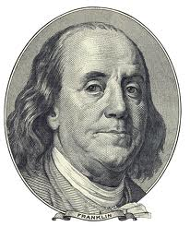
Benjamin Franklin
Along with George Washington, is the best know of Americas Founding Fathers.
He was a printer, writer, and businessman.
Throughout his life, Franklin sought ways to improve himself (individualism) and rise in society (social mobility).
He succeeded in making himself one of the world’s leading authors, philosophers, scientists, inventors, and politicians.

Slide 35
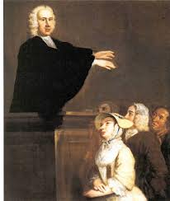
Great Awakening
Christian worship changed in the
northeastern colonies in the 1730s & 40s.
People were told that each believer should seek his or her own personal emotional relationship with God.
Ministers attracted enormous audiences and often traveled from colony to colony.
The Great Awakening brought many colonists, native Americans, and African Americans into organized Christian churches for the first time.
Christianity grew, established churches lost members to this new way of Christian worship.

Slide 36

Causes of the American Revolution
Standard 3
French & Indian War
The French & Indian War broke in 1754 when Great Britain challenged the French for control of the land that is now Ohio and western Pennsylvania.
Native Americans tended to support the French because, as fur traders, the French built forts rather than permanent settlements.

Slide 37
End of the French & Indian War
In the Treaty of Paris of 1763,Britain won control of North America; France lost most of its North American possessions
In its attempt to govern a larger colonial empire, Parliament passed a series of laws to control the colonists
  Proclamation of 1763 forbade settlement west of Appalachian Mountains to protect them from hostile Indians
  Stamp Act placed direct taxes on printed materials to pay for war debt

Slide 38
Colonial Resistance
The colonists believed the king and Parliament were violating their rights as Englishmen.
Among the rights they felt were being violated were protection from
  taxation without representation,
  the right to a trail by jury of their peers,
  protection from searches without warrants,
  protection from having troops quartered on their property.
No Taxation without Representation – colonists believed only their colonial legislatures could tax them.

Slide 39
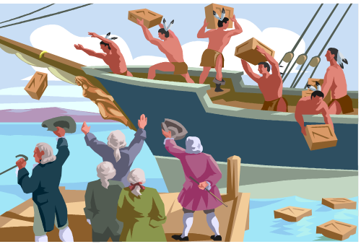
The Stamp Act required the colonists to print newspapers, legal documents, playing cards, and etc. on paper bearing special stamps.
The stamps were equivalent to paying a tax.
In response to the Stamp Act, the Sons of Liberty terrorized stamp agents
In response to the Boston Massacre, each colony formed a Committee of Correspondence to communicate with other colonies
In response to the Tea Act, the Sons of Liberty lead by Samuel Adams, dumped British tea in the Boston Harbor. This is known as the Boston Tea Party.

Slide 40
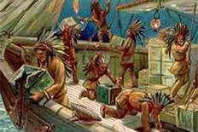
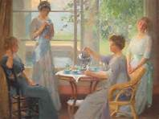
Intolerable Acts
In response to the Boston Tea Party, Parliament passed a series of laws to punish the colony of Mass., the port of Boston was closed.
The Daughters of Liberty contributed to the cause, leading boycotts of English goods, especially tea.
Colonists called for the First Continental Congress to protest these actions and formed colonial militias to resists enforcement of these acts.

Slide 41
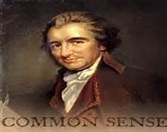
“Common Sense”
Written by patriot philosopher Thomas Paine
Message: A call for independence
This small pamphlet had a big effect on colonists and moved many Americans to support independence from Great Britain.
Sold 500,000 copies

Slide 42
Sample Question:
Which event was NOT a direct result of the French and Indian War?
Proclamation of 1763
Stamp Act
Treaty of Paris of 1763
Tea Act

Slide 43
Correct Answer:
D. Tea Act

Slide 44
Sample Question
The Sons of Liberty
The Daughters of Liberty
The committees of correspondence
Which issue caused British colonists to form the organizations in the list above?
The British Parliament had passed series of taxes on its North American colonies.
Native Americans had attacked British colonial outpost within the Northwest Territory.
British naval vessels had seized colonial ships and forced colonial sailors into service in the British navy.
Armed slave rebellions had begun throughout the British colonies to end the continued practice of slavery.

Slide 45
Answer
A. The British Parliament had passed series of taxes on its North American colonies.

Slide 46
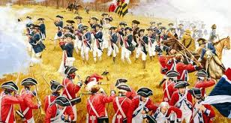
IDEOLOGY OF THE AMERICAN REVOLUTION
Standard 4

Slide 47
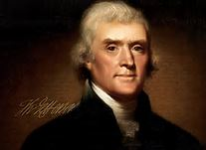

Declaration of Independence
Author: Thomas Jefferson
Based on John Locke’s Enlightenment philosophy
  “All men are created equal”
  All have natural, unalienable rights
    Life
    Liberty
    Pursuit of happiness (Locke said “property”)
  Government gets its powers from the consent of the people.
  People have a right to alter or abolish their government after a long period of abuses.

Slide 48

Declaration of Independence
The Declaration of Independence explains the philosophical reasons for seeking independence from Britain.
In its longest section, it gives examples of how King George III violated the rights of the colonists.

Slide 49
Sample Question
John Locke’s theory that all people have basic natural rights directly influenced
The Proclamation of 1763
The Declaration of Independence
The outbreak of the French and Indian War
The expansion of transatlantic mercantilism

Slide 50
Answer: B. The Declaration of Independence

Slide 51
Sample Question
Which idea from the Social Contract Theory is expressed within the U.S. Declaration of Independence?
Congress must consist of two legislative houses.
Political term limits are necessary for all elected officials.
Government authority comes from the consent of the governed.
Individual citizens must be protected by a federal bill of rights.

Slide 52
Answer
C. Government authority comes from the consent of the governed.

Slide 53
American Revolution
The war for independence fought between Britain and 13 of its colonies in North America
1775-1783

Slide 54
George Washington
Commander of the Continental Army during the Revolution.
Took an all volunteer, undisciplined, inexperienced army and turned it into a professional army.
He reorganized the army and secured additional equipment and supplies.

Slide 55

Battles of the
American Revolution
Battles at Lexington and Concord (1775) - Battles that started the American Revolution.

Slide 56
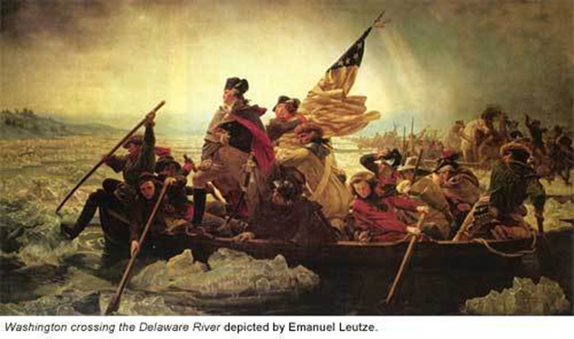
Battle of Trenton
Christmas, 1776
Washington’s army, who had volunteered for one year of service, was about to go home
There had been no victories for the army and no reason to reenlist
General Washington planned a surprise attack on Hessian soldiers across the Delaware River from the Continental Army
  Washington and his army crossed the Delaware in the middle of the night (see next slide)
  In the early morning, they attacked the Hessians and won
  In a few days, they defeated a British force at Princeton, NJ
  Many men in Washington’s army, reenlisted and new recruits joined

Slide 57
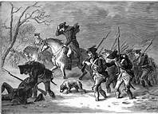
Valley Forge, PA
Winter of 1777-78
Washington and the Continental Army are camped at Valley Forge
They have little food
They have poor shelter
Many have no shoes or blankets to keep them warm
Yet Washington rallies his troops, inspires them, and uses the time to prepare them for battle

Slide 58
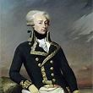
Battle of Saratoga (October, 1777)
Colonist victory over British.
Turning point in Revolutionary War.
Convinced the French to become ally of the United States
Benjamin Franklin played a key role, as the U.S. diplomat to France, in convincing them to form this alliance
The Marquis de Lafayette volunteers to fight. He commanded American troops and fought battles in many states.

Slide 59
Battle of Yorktown (1781)
Yorktown is located on the peninsula formed by the James and York Rivers that flow into the Chesapeake Bay
Washington and his army entrench themselves on the land side of Yorktown
The French fleet blocks the entrance to the Chesapeake Bay
Lord General Charles Cornwallis and the British surrender
The American Revolution is over!

Slide 60
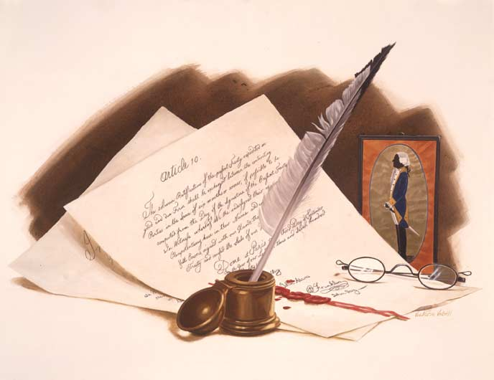
Treaty of Paris (1783)
Officially ended the Revolutionary War.
British recognized colonists’ independence.
British gave colonists all the lands east of the Mississippi River
Britain ceded Florida to Spain and certain African and Caribbean colonies to France.

Slide 61
Sample Question:
What battle led the French to form a military alliance with the United States against the British?
Concord
Trenton
Saratoga
Yorktown

Slide 62
Correct Answer:
C: Saratoga

Slide 63
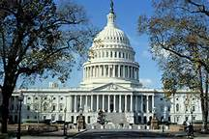
Establishing a New Government
Standard 5

Slide 64
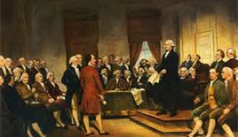
Constitutional Convention
1787
James Madison introduced a new plan of government to address the Weaknesses in the Articles of Confederation.
  No executive branch
  No power to tax
  No power to regulate commerce
  No established national currency
The Constitutional Convention, held in Philadelphia, PA resulted in the creation of a FEDERAL government . With a separate executive, judicial ,and legislative branches.
The convention replaced the Articles of Confederation with the U.S. Constitution

Slide 65
Shays’s Rebellion
Daniel Shays led more than a thousand farmers, like him, burdened with War debt as a result of the Revolutionary War.
Shays and his men tried to seize a federal arsenal in Massachusetts.
Responding to Shays’s Rebellion, Washington supported the establishment of a stronger central government.
Washington was elected president of the Constitutional Convenetion.

Slide 66

Great Compromise of the Constitutional Convention
Virginia Plan
  Bicameral Congress
  Representation of both houses based on population of the individual states
New Jersey Plan
  Unicameral Congress
  Representation of states
  would be equal
Great Compromise
Bicameral legislature
Representation in the House of Representatives would be based on population of each state
Representation of the Senate would be equal with 2 senators from each state

Slide 67
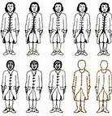
The Slavery Debate in the Constitutional Convention
Debates over slavery resulted in an agreement to outlaw the importation of slaves from Africa within 20 years (by 1808)
  Southern states being able to count 3 out of 5 slaves in its census for the purpose of representation in Congress (Three-fifths Compromise)
    However, this formula would also be considered for the appropriation of taxes per state

Slide 68
Limited Government
The federal government’s powers are limited to those specified in the U.S. Constitution

Slide 69
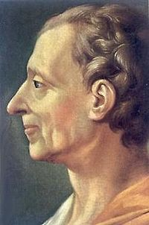
Montesquieu, Enlightenment Thinker
The framers were greatly influenced by the ideas of Charles de Montesquieu, Enlightenment thinker.
Championed the idea of Separation of Powers.
The rights guaranteed the US citizens by the Constitution limited the power of the government.

Slide 70
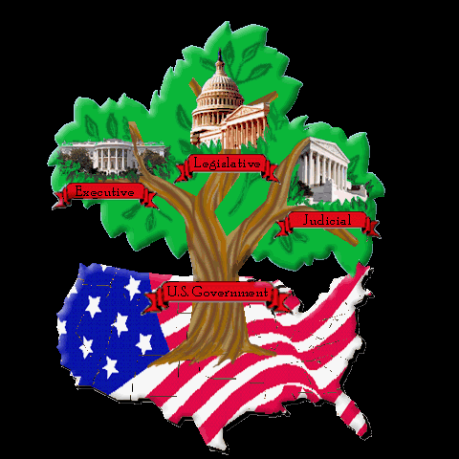
Separation of Powers
Each branch of government has a specific purpose and powers are different from the other branches
  A Legislative branch (Congress) – Makes the Laws
  An Executive branch (the President) – Enforces the Laws
  A Judicial branch (Supreme Court) – Interprets the Law.

Slide 71
Checks and Balances
Each branch of the government checks the powers of the other two branches
Prevents any branch of government from becoming too powerful

Slide 72
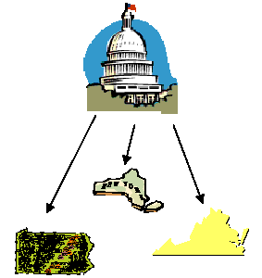
Federalism
Distribution of the powers of government between a central (federal) government and the regional (states) governments.
State laws cannot interfere with federal law

Slide 73
Federalists vs. Anti-federalists
Federalists
  Supported ratification of U.S. Constitution
  Supported strong central (national) government
  Believed it kept factions from becoming too powerful
  Believed the President’s powers would be check by the other branches
  Every state had its own Bill of Rights; that was sufficient
Anti-Federalists
  Opposed ratification of the U.S. Constitution
  Felt power of government should remain with the individual states
  Believed factions could not be controlled from taking power
  Believed the President could become like a dictator with his power as commander-in-chief
  Especially concerned about the absence of a Bill of Rights to protect the rights of citizens

Slide 74
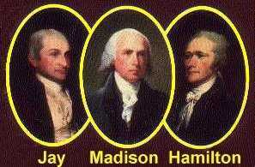
Federalist Papers
Newspaper articles published in New York
Explained reasons why the states should ratify the new US constitution
The promise of the Bill of Rights convinced a majority of voters to support the Constitution.
The anonymous authors: Alexander Hamilton, James Madison, John Jay

Slide 75

Bill of Rights
Freedom of Speech, Press, Religion and Petition
Right to keep and bear arms
Conditions for quarters of soldiers
Right of search and seizure regulated
Provisions concerning prosecution
Right to a speedy trial, witnesses, etc.
Right to a trial by jury
Excessive bail, cruel punishment
Rule of construction of Constitution
Rights of the States under Constitution

Slide 76
Sample Question
The Bill of Rights was adopted by Congress in 1791 to preserve which political principle?
The separation of powers
The restriction of political terms
The prohibition of racial discrimination
The limitation of the federal government

Slide 77
Answer: D
The Bill of Rights limited the federal government’s ability to interfere with individuals’ and states’ rights.

Slide 78
Political Parties
George Washington was the most influential and popular figure in the US.
He made Thomas Jefferson Secretary of State and Alexander Hamilton Secretary of Treasury.
Jefferson and Hamilton had significant differences of opinion about the legitimate power of the government.
Jefferson believed the national government must limit its power to what is in the Constitution.

Slide 79
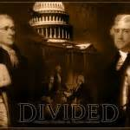
Hamilton wanted to expand the power of the government to stabilize the nation and its economy.
At the end of Washington’s 2nd term, the two men and their supporters attacked one another and competed to replace him.
Washington warned about the dangers of political parties (factions) in his farewell address.

Slide 80
Early Presidents
George Washington
  Proclaimed U.S. neutrality in the war between England and France
  As commander in chief, sent troops to stop the rebellion over the whiskey tax (Whiskey Rebellion)
  First political parties formed during this presidency
    Federalists (Hamilton)
    Democratic-Republicans (Jefferson)
John Adams
  Federalist
  Sent representatives to France to negotiate problems
    French officials tried to bribe them
    Referred to as the XYZ Affair
    Led to a Quasi War with France

